Slide 1
X Education - Lead Scoring Case Study
Identification of Hot Leads to focus more on them and thus enhancing the conversion ratio for X Education
Group Members:
Bharath
Vinod
SAMIRAN BHALE

Slide 2
Background - X Education Company
X Education , An education company named sells online courses to industry professionals
Many interested professionals land on their website
The company markets its courses on several websites like Google. Once these people land on the website, they might browse the courses or fill up a form for the course or watch some videos

Slide 3
Background - X Education Company
When these people fill up a form providing their email address or phone number, they are classified to be a lead
Once these leads are acquired, employees from the sales team start making calls, writing emails, etc. Through this process, some of the leads get converted while most do not
The typical lead conversion rate at X education is around 30%

Slide 4
Problem Statement - X Education Company’s Problem
X Education gets a lot of leads but its lead conversion rate is very poor
To make this process more efficient, the company wishes to identify the most potential leads, also known as ‘Hot Leads’
If they successfully identify this set of leads, the lead conversion rate should go up as the sales team will now be focusing more on communicating with the potential leads rather than making calls to everyone

Slide 5
Problem Statement - X Education Company’s Problem
We will help them to select the most promising leads, i.e. the leads that are most likely to convert into paying customers.
We are required to build a model wherein we need to assign a lead score to each of the leads such that the customers with higher lead score have a higher conversion chance
The CEO, in particular, has given a ballpark of the target lead conversion rate to be 80%.

Slide 6
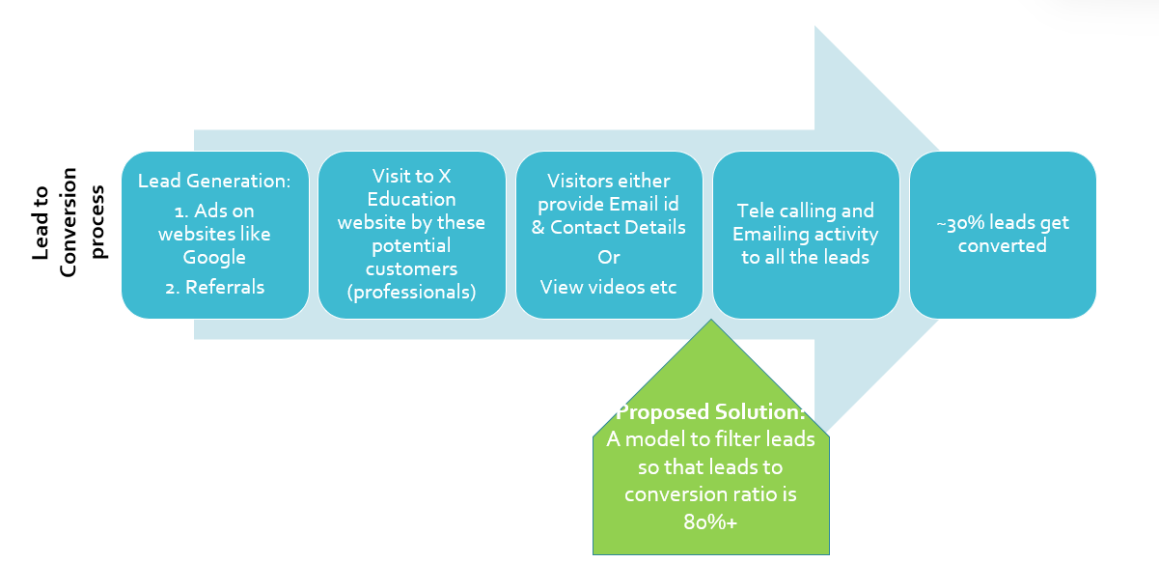
Lead – Conversion Process

Slide 7
Proposed Solution
Selection of Hot Leads
Communicating with Hot Leads
Conversion of Hot Leads
Leads Clustering
We cluster the leads into certain categories based on their tendency or probability to convert, thus, getting a smaller section of hot leads to focus more on.
Focus Communication
Since we would have a smaller set of leads to have communication with, we might make more impact with effective communication.
Increase conversion
Since we focused on hot leads, which were more probable to convert, we would have a better conversion rate, and hence we can achieve the 80% target.

Slide 8
Solution - Selection of Hot Leads
For our Problem Solution, the crucial part is to accurately identify hot leads.
The more accurate we obtain the hot lead, the more chance we get of higher conversion ratio.
Since we have a target of 80% conversion rate, we would want to obtain a high accuracy in obtaining hot leads.

Slide 9
Implementation

Slide 10
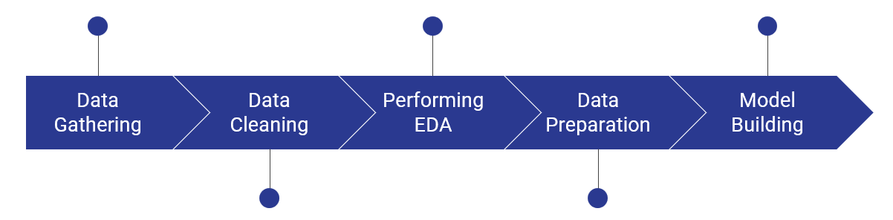
Lead – Conversion Process
Loading & Observing the past data provided by the Company
Univariate, Bivariate, and Heatmap for numerical and categorical columns
Performing pre-requisites for RFE and Logistic Regression
Duplicate removal, null value treatment, unnecessary column elimination, etc.
Outlier Treatment, Feature-Standardization

Slide 11
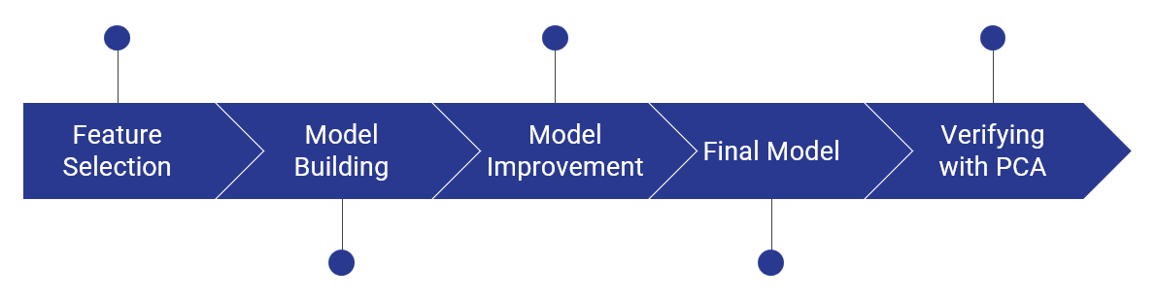
Lead – Conversion Process
Verifying our Final Model Accuracy etc. with model built with PCA
Selection of top 25 features using RFE
Reduction of columns and Model re-building
Model building using RFE for selected columns
Final Model Analysis and performance on Test Data

Slide 12
Plots (Visualization)

Slide 13
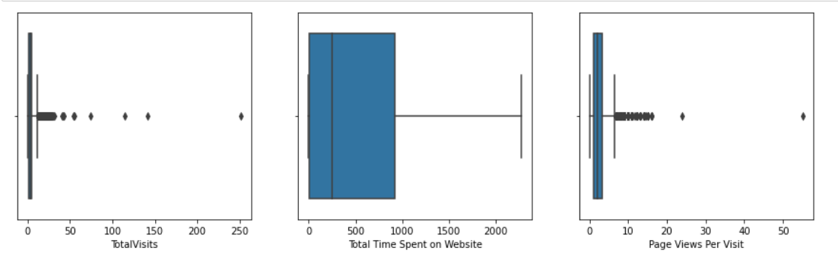
We can see that there are few outliers in "Total Visits" and "Page Views Per Visit" columns. There are no outliers in "Total Time Spent on Website". Let’s remove the outliers of those columns.
We are removing the outliers in 10th and 90th percentile.

Slide 14
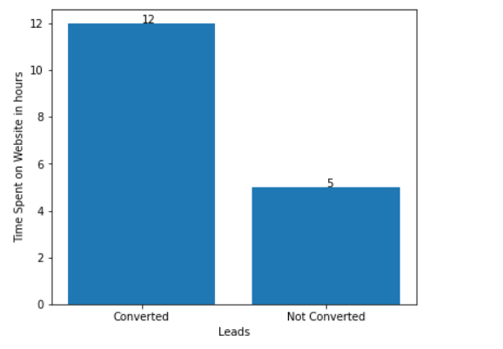
Average Leads of the converted and not converted customers

Slide 15
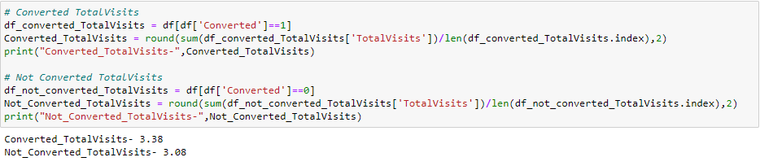

Slide 16
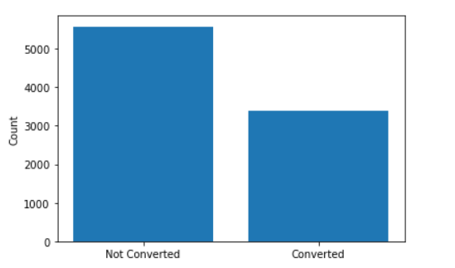
Count of converted and not converted customers

Slide 17
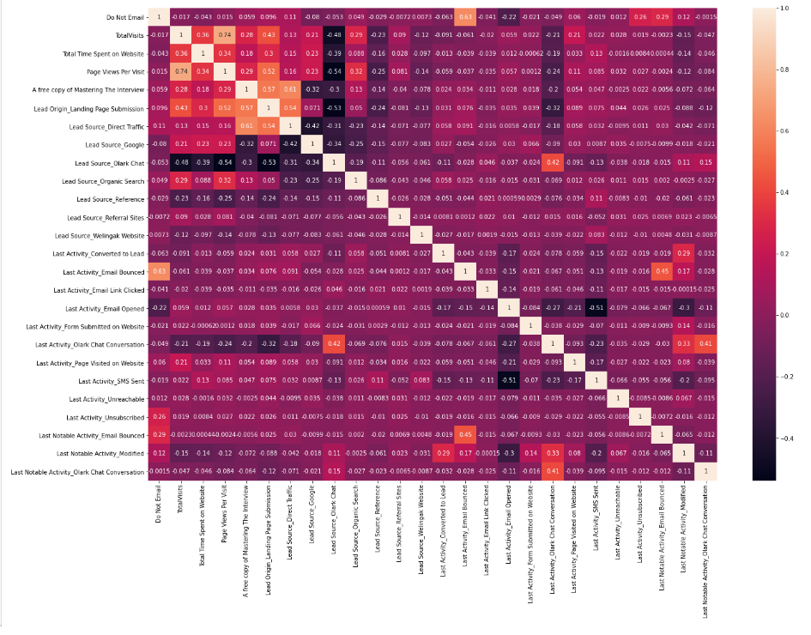
EDA plots depicting correlation (Heat Map)

Slide 18
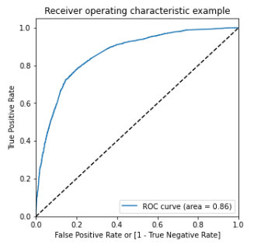
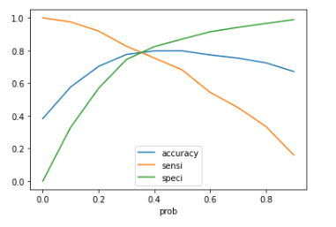
Analysis of the above curve Accuracy - Becomes stable after 0.35
At point 0.35 where the three parameters cut each other, we can see that there is a balance between sensitivity and specificity with a good accuracy.
So, 0.35 may be the optimal cutoff.
Gini of the model We can see from the ROC curve, that the area of the curve is 0.86, which is the Gini of the model.

Slide 19
Inference/Conclusion

Slide 20
Model Analysis - Performance of our Final Model
Overall accuracy on Test set: 0.79
Sensitivity of our logistic regression model: 0.79
Specificity of our logistic regression model: 0.78

Slide 21
Inferences from Model - Business Insights Derived from our Model
Top 3 variables in model, that contribute towards lead conversion are:
Total Time Spent on Website
Last Notable Activity_SMS Sent
TotalVisits

Slide 22
Inferences from Model - Business Insights Derived from our Model
Top 3 variables in my model, that should be focused are:
Last Activity_SMS Sent (positively impacting)
Last Activity_Olark Chat Conversation (negatively impacting)
Lead Source_Olark Chat (negatively impacting)

Slide 23
Conclusion 1 (LR Model)
Our Logistic Regression Model is decent and accurate enough, when compared to the model derived using PCA, with 0.79 Accuracy on Test Set, 0.79 Sensitivity and 0.78 Specificity.
We can vary these parameters by varying the cut-off value and thus predict Hot leads based on scenarios like availability of extra resources and vice-versa.

Slide 24
Conclusion 2 (Recommendation)
X Education Company needs to focus on following key aspects to improve the overall conversion rate:
Increase user engagement on their website since this helps in higher conversion
Increase on sending SMS notifications since this helps in higher conversion
Get Total visits increased by advertising etc. since this helps in higher conversion
Improve the Olark Chat service since this is affecting the conversion negatively

Slide 25
Thank you
Group Members:
Bharath
Vinod
SAMIRAN BHALE

